Slide 1
Working Scientifically Lesson 1:
Presenting Data in Tables

Slide 2
Learning Objective
To record data accurately and appropriately.
Success Criteria
To identify the most important aspects of a results table.
To understand how to organise data in a table format.
To analyse the data and suggest improvements.

Slide 3

Starter
An investigation to find out how changing the temperature of water affects the time taken for a substance to dissolve. What should be changed about this table of results? Why?
 | Temperature
74 | 10°C
69 | 20°C
57 | 30°C
45 | 40°C
30s | 50°C
Temperature (°C) | Time taken to dissolve (s)
10 | 74
20 | 69
30 | 57
40 | 45
50 | 30
Extension
Are the results repeatable? If they are, how can you tell? If not, what would you need to do to check repeatability?
Answer:
No, you cannot tell if the results are repeatable because you only have one set of data. You would need to repeat the experiment to see if the results were similar.

Slide 4


What to Include
Summarise what should be included in a table and where it should go.
Independent variable goes here. Don’t forget units.
Dependent variable goes here. Don’t forget units.
 | Trial 1 | Trial 2 | Trial 3 | Mean/Average
Independent variable in the left-hand column.
Dependent variable in the right-hand column.
Space for at least three trials.
Units in the column headings (if there are any).
Mean/average column.

Slide 5
Design a Results Table
Design a results table for an investigation into the materials that bags are made from. How does the material affect the amount of weight the bag can hold before it breaks? You will peer assess each other’s tables and give a mark out of 5.
Independent variable here.
1 mark
Dependent variable here.
1 mark
Units here.
1 mark
bag material | breaking point (g/kg)
 | trial 1 | trial 2 | trial 3 | mean/average
thin plastic
thick plastic
canvas
paper
Labelled space for repetitions. 1 mark
Labelled space for mean or average. 1 mark
What could this information be used for?

Slide 6

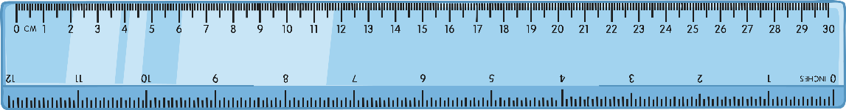
Class Variation
Produce a table that will allow you to collect data from people in your class.
Name
height,
eye colour,
arm span,
gender.
You will need a metre ruler to measure height and arm span with.
Remember:
No repetition or average/mean columns are needed, because the data is discrete (it can only ever take certain values).

Slide 7
Answers
Your table should look something like this:
Name | Height | Eye Colour | Arm Span | Gender
Once the table is drawn, go round the class and collect as much data as you can (collect from at least 5 different people).

Slide 8
Results Analysis
Bronze
What is the most common eye colour?
Describe how you would calculate the average height of the class? Calculate the average height of everyone in your class.
Silver
Is there a link between height and arm span?
How could you show that link better than the results table?
Gold
How could you look at the range of heights within the class?
What other data from the table could you analyse?

Slide 9
Height Ranges
Use the ranges below for your data.
Height Range (cm) | Frequency
0-145
146-149
150-159
160-169
170-179
179-180
180-189
190-260
Add a tally of the number of people, in this column.
Using the data already collected for height, draw another results table.
Place the frequency of heights into the results table.
Extension: What could you do with the results now?
Make a graph

Slide 10

Extension
You could draw a frequency graph of your results.
What is the shape like?
Frequency
Height
Why is it shaped like this?
The graph shows the normal distribution of heights within a population. The average height having the highest frequency.

Slide 11
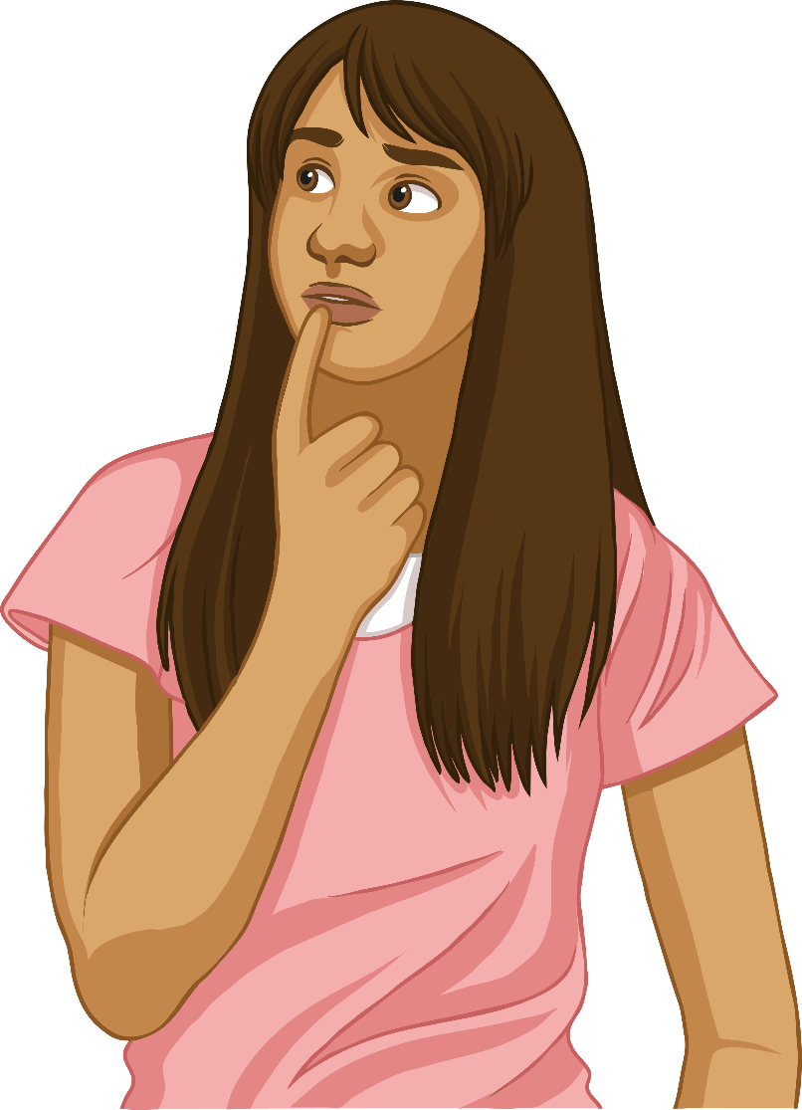
Questions
Super
Reorganise your data from youngest to oldest. What can you conclude? Explain the reasons for your conclusion.
What is the most frequent eye colour?
Put the height frequency data in order. What are the most frequent heights?
Stretching
Are there any anomalies in your data? How do you know?
Is there enough data to draw a conclusion?
Why might you re-order your data?
Is there a link between height and age?
What could you do with the data next?

Slide 12

Feedback
Summarise what you found from your data collection.
Are there any differences in conclusions drawn? Why?

Slide 13

Plenary
True or False?
The control variable goes in the right-hand column.
The independent variable goes in the left-hand column.
When calculating an average/mean, you should leave out anomalies.
Sometimes you need to re-order data to see patterns more clearly.
It is easier to see trends and patterns in tables than graphs.

